Slide 1

SEPTEMBER 16, 2023
GRAPES TO GRADES: WINE SCORES PREDICTIONS
Andreia Jardim

Slide 2
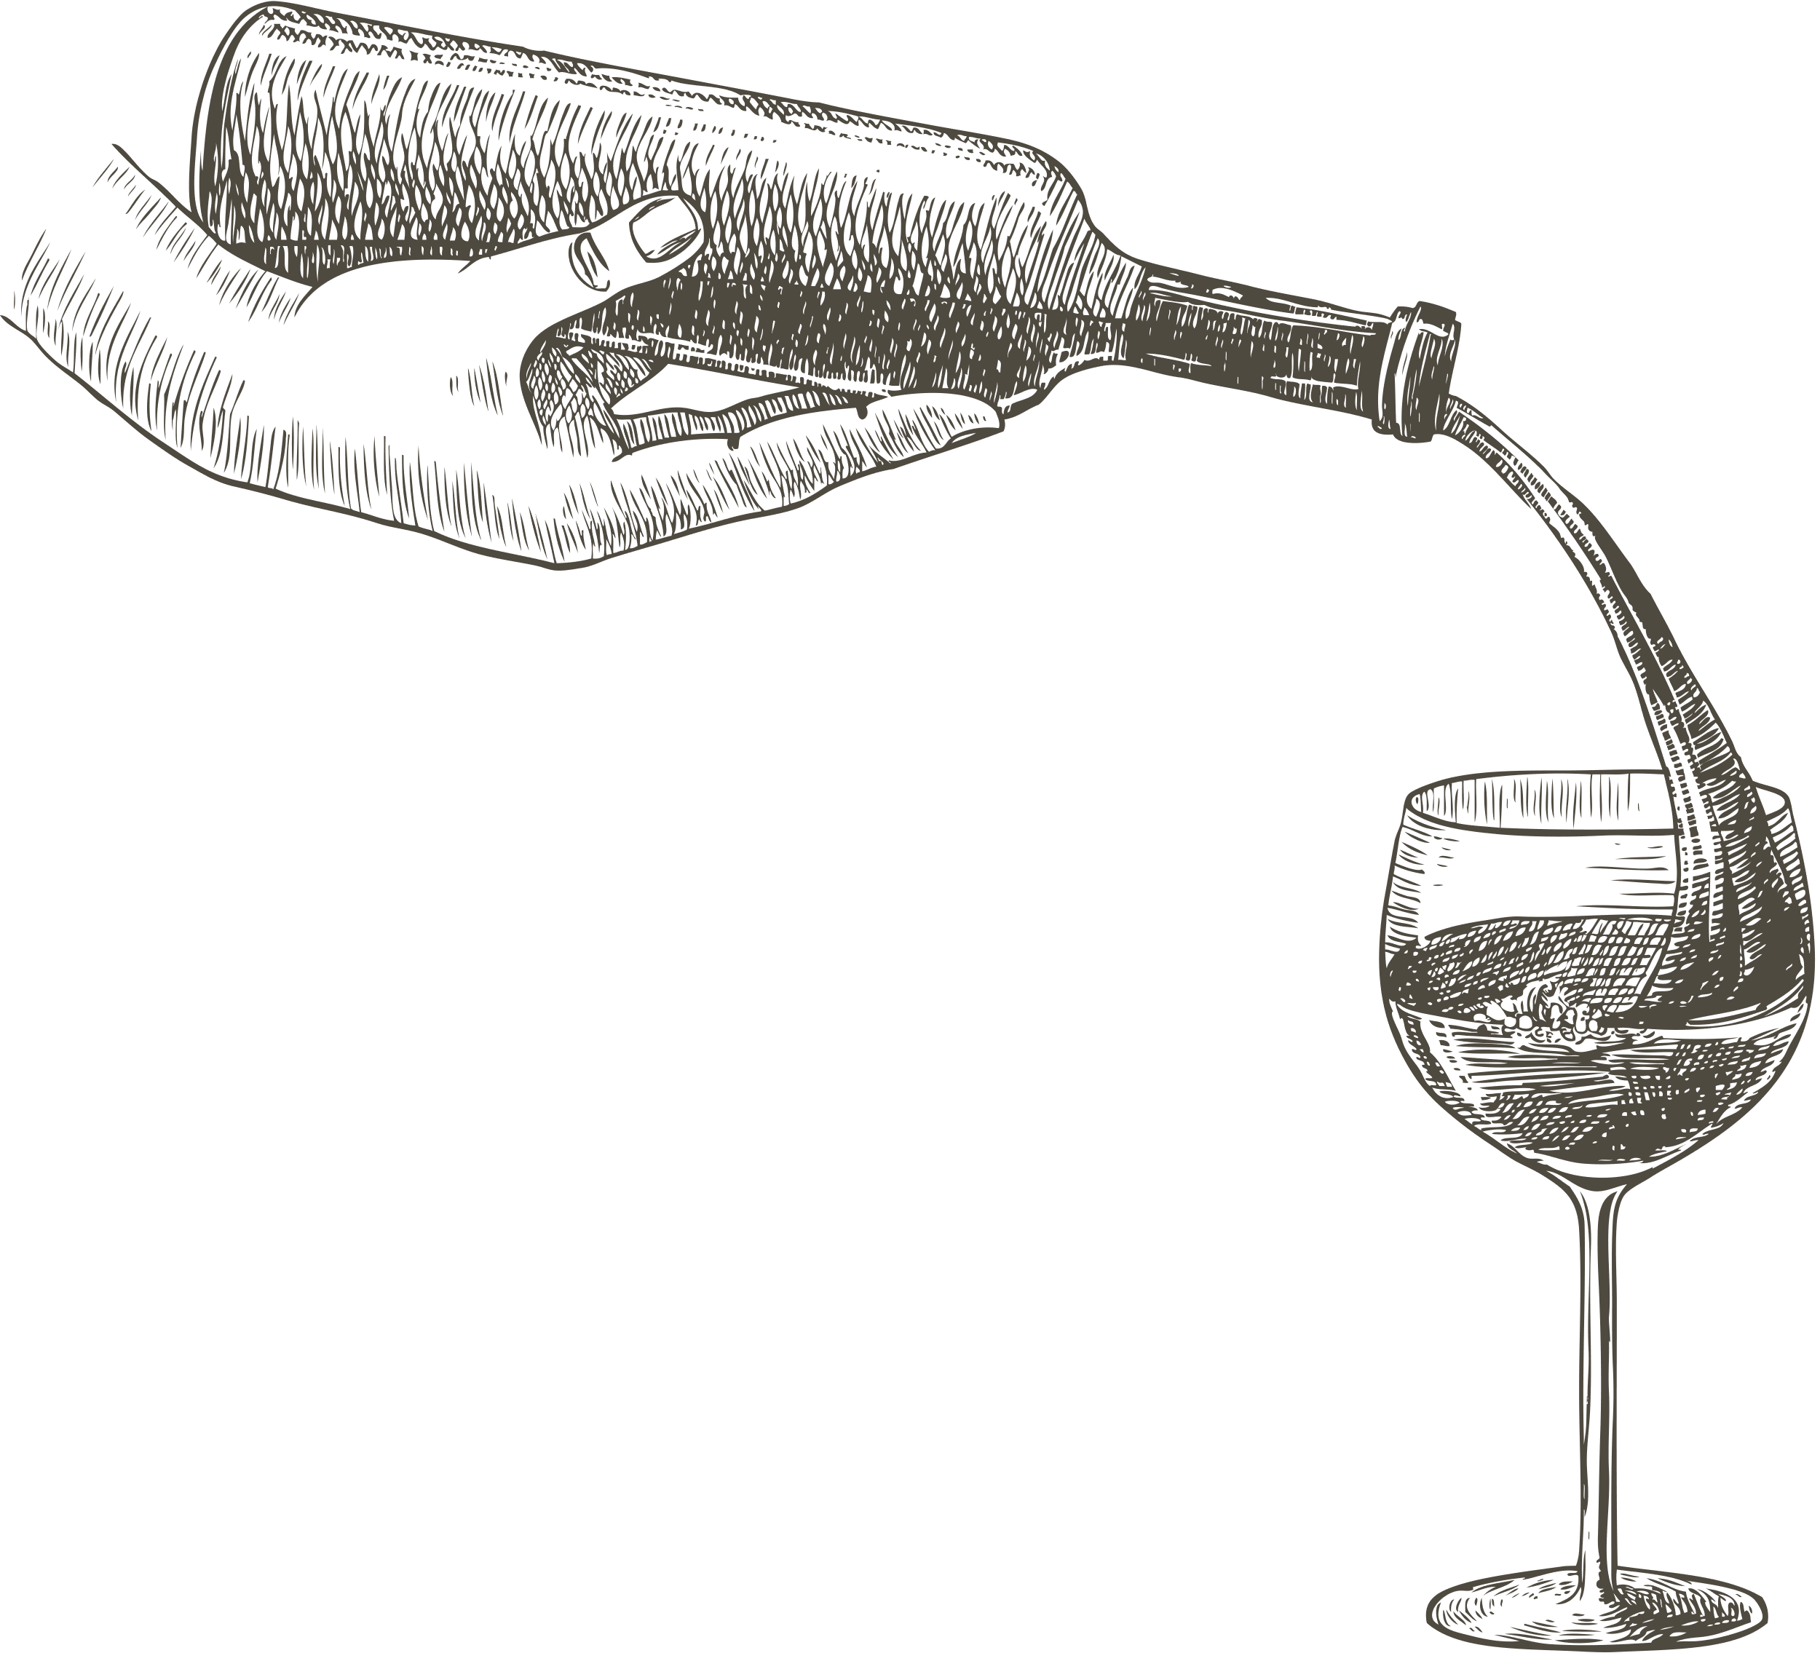
Presentation Overview
Introduction
Technical Developments
Live Demonstration
Conclusion

Slide 3

Introduction
In today's competitive wine market, understanding what makes a wine successful is crucial for winemakers and wine enthusiasts alike.
Portugal boasts a rich tradition of winemaking dating back centuries.
Unique terroirs in Portugal result in a wide variety of wine styles.
ABOUT THE WINE
Notes:
Wine is not just a beverage; it's a symbol of culture and craftsmanship. Portugal has a long history of wine production.
Portugal unique regions have a wide variety of wine styles.
In today's competitive wine market, understanding what makes a wine successful is crucial for winemakers and wine enthusiasts alike.

Slide 4

Introduction
BUSINESS PROBLEM
Winemakers face the challenge of predicting the potential rating of a wine before production to make informed decisions.
Accurate wine rating predictions have implications, such as:.
Improved market positioning by aligning wine characteristics with consumer preferences.
Enhanced consumer experiences as they discover wines tailored to their tastes.
Solving this problem can elevate the entire winemaking and wine appreciation experience
Notes:
"Winemakers strive to predict wine ratings before production to make informed decisions.
Accurate predictions benefit the wine industry by improving market positioning, aligning wine characteristics with consumer preferences, and enhancing the overall wine appreciation experience.
Addressing this challenge elevates the entire winemaking and wine appreciation process."

Slide 5
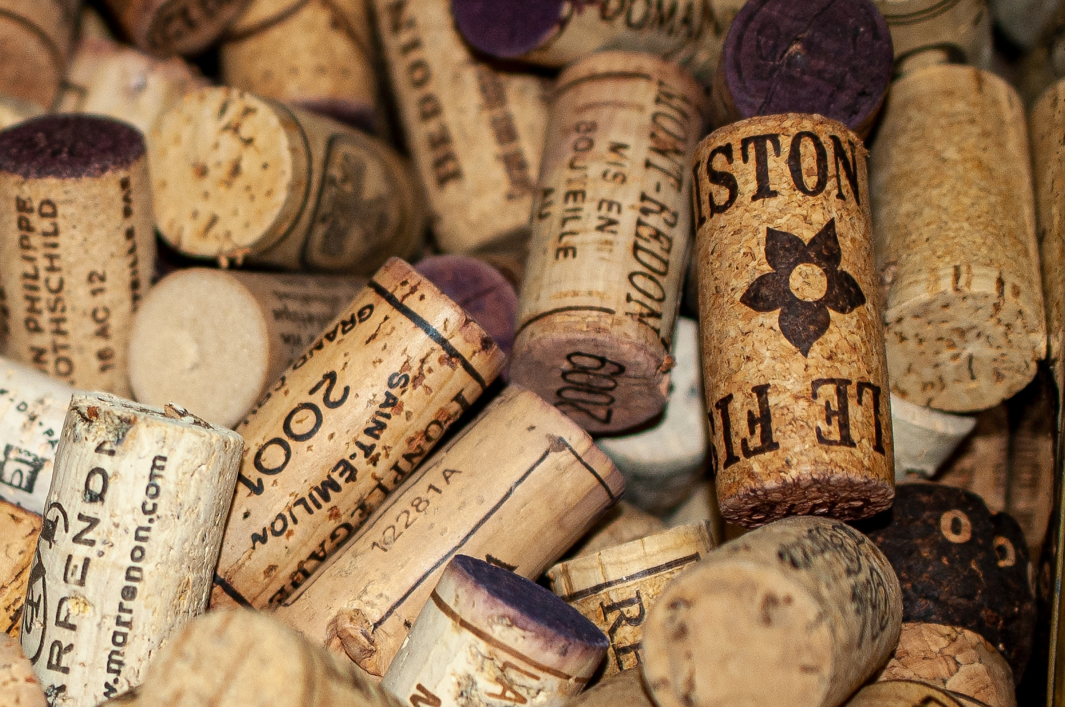
TECHNICAL DEVELOPMENTS

Slide 6


DATA SOURCES
VIVINO.COM
pordata.pt
Get the list of wines and its charactristics
Get Temperature and Precipitation data

Slide 7
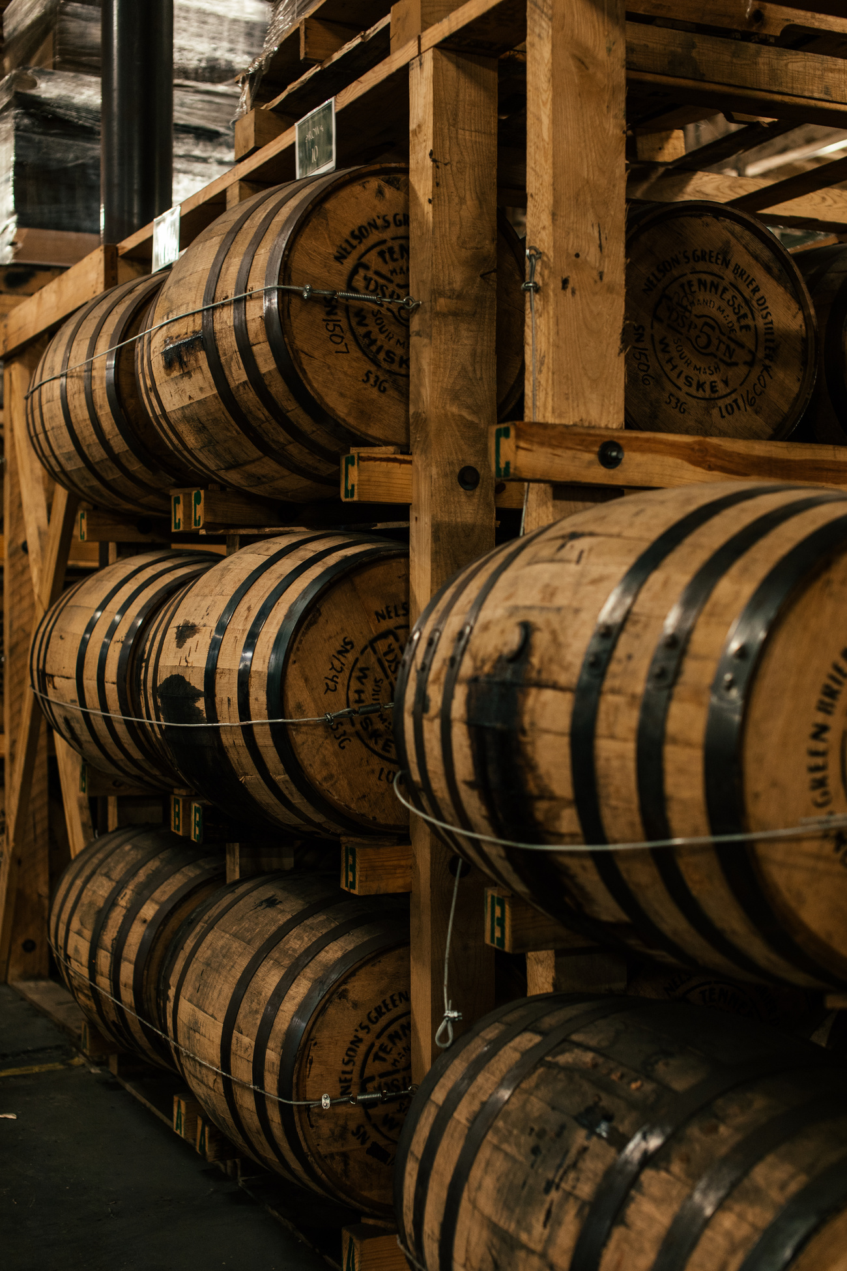
VIVINO.COM - USING SELENIUM
Filter the wine search for each wine type: Red, White, Sparkling, Rosé, Dessert and Fortified (one at the time);
From each card loaded on the page, get a dataframe with Wine Type, Wine Link, Wine Name, Winery, Wine ID and Year;
For each wine, get the information for each year (accept cookies and read info from popup windows);
For each wine get wine characteristics (Grapes, Region, Wine Style, Alcohol Content, Ratings, Average Rating, price and Allergens).
pordata.pt
Merged information about the temperature and percepitation with previous data according to year and region

Slide 8

PREDICTIVE MODEL FOR WINE RATINGS
SUPERVISED LEARNING - REGRESSION
Random Forests
Target – Wine Rating
Feature - Grapes, Region, Ratings, Price, Allergens, Temperature and Precipitation.
MODEL EVALUATION
Mean Absolute Error (MAE): 0.1308
Notes:
this means is that, on average, our model's predictions for wine ratings are off by approximately 0.1308 points. In practical terms, this is a highly encouraging result for several reasons:
Accuracy: A lower MAE indicates that our model is quite accurate in predicting wine ratings. The fact that our MAE is close to zero means that, on average, our predictions are very close to the actual ratings given by wine experts or consumers.
Usefulness: Winemakers and wine enthusiasts can rely on our model to make informed decisions. With an MAE of 0.1308, the predictions are trustworthy and can guide decisions on which wines to produce, stock, or purchase.
Improvement: It's worth noting that the MAE can serve as a benchmark for continuous improvement. As we collect more data and refine our model, we have the potential to further reduce this error and make our predictions even more accurate.

Slide 9




Web App - Streamlit
PREDICTIVE MODEL
POWER BI EMBEDDED
Estimate the average wine rating, based on user inputs
Portfolio of Portuguese wines

Slide 10

LIVE DEMONSTRATION

Slide 11

Conclusion
This work introduces a Streamlit app powered by predictive modeling and Power BI.
It empowers winemakers with predictive insights, helping them produce wines with higher chances of success.
Enriches the wine discovery experience for enthusiasts, leading to more satisfying choices.
Improvements:
The model has the potential for further improvements through continuous data collection and model refinement.
With more data and algorithms fine-tune, there will be more significant positive results.

Slide 12

THANK YOU

